Slide 1

Sampling Methods & Sample Size
W E E K
W
E
MKTG 2341 Lec 8
Notes:
NOTE: Classroom Lab 9 deals with B2B Research – some of that could be build into the lecture to free up lab time.

Slide 2
Learning Objectives
Sampling Methods (Chapter 10):
Define the concept of sampling.
Identify the steps in a Sampling Plan
Explain differences between probability samples and non-probability samples.
Sample Size (Chapter 10):
Identify the factors affecting sample size determination
Calculate the sample size for a probability sample.
MKTG 2341 Lec 8

Slide 3
What is Sampling?
The process of collecting information from a subset of a larger group.
A market researcher takes the results from the sample to make estimates of the larger group.
MKTG 2341 Lec 8
Notes:
Sampling a small percentage of a population can result in very accurate estimates.
The sample must be selected in a scientific manner if you want it to be representative of the target population.

Slide 4
Basic Concepts in Sampling
Census: a survey of the complete population.
Sample: a subset of the population that should represent the entire group.
Sampling Error: any error in a survey that occurs because a sample is used.
MKTG 2341 Lec 8
Notes:
Reasons for Taking a Sample:
Practical considerations such as cost and population size
Inability of researcher to analyze huge amounts of data generated by census
Samples can produce precise results

Slide 5
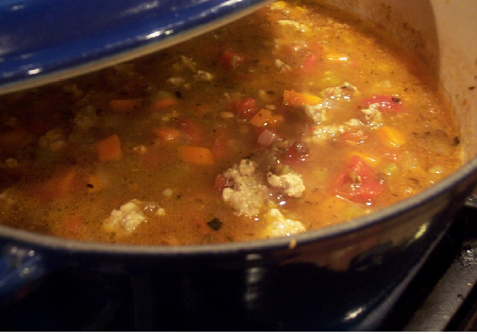
Why Sample?
MKTG 2341 Lec 8
Notes:
Soup Pot Sampling Analogy
To fully understand what the soup is and tastes like, you don’t have eat the whole pot
However, taking one spoonful might not be enough, because you might only get the broth, or just a piece of meat or vegetable
To fully understand what the soup tastes like, you should take several spoonfuls from different parts of the pot, the top, the bottom, and so on

Slide 6
Developing a Sample Plan
Sample Plan:
Sequence of steps that you, as the researcher, go through to draw and ultimately arrive at the final sample.
MKTG 2341 Lec 8

Slide 7
Developing a Sample Plan
Step 8: Develop & Execute Operational Plan
Step 2: Analyze
Research Method
Step 7: Validate the Sample
Step 1: Define the Population
Step 6: Draw the Sample
Step 3: Choose Sampling Frame
Step 5: Determine Sample Size
Step 4: Select a Sampling Method
MKTG 2341 Lec 8
Notes:
We covered steps 1-4. Chapter 10 covers Step 5 Sample Size.

Slide 8
Step 1: Define the Population
Population: the entire group under study as defined by research objectives.
The population is made up of units.
  Very specific terms
  E.g., “Number of households within each of Burnaby’s 37 Planning Study Areas.
  Creates screening question: What is your current address?
MKTG 2341 Lec 8
Notes:
Population: the entire group under study as defined by research objectives.
Also referred to as Target Population
Requires good logic and judgment.
Based on the characteristics of current or target customer.
Researchers define population units in specific terms.
Create Screening Questions to eliminate individuals who do not belong in the target population

Slide 9
Step 2: Analyze Research Method
Research methods have implications for the sampling process.
Examples:
  Online survey - purchase randomly selected Panel sample.
  Telephone survey – purchase a randomly selected contact list from Dominion Directory
Specified in the research proposal
MKTG 2341 Lec 8

Slide 10
Step 3: Choose Sampling Frame
Sampling Frame: master list of the entire target population.
Example
  Sampling frame for the general population: Telephone book/list of all published numbers.
  Sampling frame for a survey of businesses in a particular industry: Industry association directory.
  Sampling frame for a customer satisfaction survey: List provided by the client.
MKTG 2341 Lec 8

Slide 11
Step 3: Choose Sampling Frame
Incidence Rate: the percentage of people who qualify as members of the population.
Sampling Frame Error: extent to which the sampling frame fails to account for all individuals in the target population.
  E.g., Telephone book excludes unlisted numbers and people who only have cell-phones.
MKTG 2341 Lec 8

Slide 12
Step 4: Select Sampling Method
The selection of sampling methods will depend on:
  The objectives of the study
  The financial resources available
  Time limitations
  The nature of the problem
MKTG 2341 Lec 8

Slide 13
Step 4: Select Sampling Method
Two Basic Sampling Methods
Probability Samples:
  Elements selected in a random manner.
  Members of the population have a known chance (probability) of being selected into the sample.
Non-Probability Samples:
  Elements selected in a non-random manner.
  Chances (probability) of selecting members from the population into the sample are unknown.
MKTG 2341 Lec 8

Slide 14
Sampling Methods
Sampling Methods
Probability Samples
Non-probability Samples
Simple Random
Systematic
Convenience
(incl. Intercept)
Judgment
Stratified
Cluster
Snowball
Quota
MKTG 2341 Lec 8

Slide 15
Step 4: Select Sampling Method
Characteristics of Probability Samples:
Representative of the total population.
Results can be projected to total population.
Sampling error can be calculated.
However …
More expensive than non-probability samples.
Take more time to design and execute.
MKTG 2341 Lec 8
Notes:
Very important slide!

Slide 16
Step 4: Select Sampling Method
Characteristics of Non-Probability Samples:
NOT Representative of the total population.
Results can NOT be projected to total population.
Sampling error can NOT be calculated.
However …
Cost less than probability samples.
Can be conducted more quickly.
Techniques can make it more representative.
MKTG 2341 Lec 8
Notes:
Very important slide!

Slide 17
Probability Sampling Methods
Simple Random Sampling:
Probability of being selected into the sample is “known”, non-zero, and equal for all members of the population.
Requires a complete list of the population.
  E.g. Blind Draw Method
  E.g. Random Numbers Method
MKTG 2341 Lec 8
Notes:
Example: A list of all dentists in Vancouver, assign numbers to each, select from the list using randomly generated numbers
Advantage – same as for Probability Samples in general:
Representative of the total population.
Results can be projected to total population.
Sampling error can be computed.
Disadvantages:
Complete list of population is needed.
Cumbersome to provide unique identification of every population member.

Slide 18
Probability Sampling Methods
Systematic Sampling:
Method to select a random sample from a large directory or list.
Much more efficient than Simple Random Sampling.
Fixed skip interval to draw elements from population.
MKTG 2341 Lec 8
Notes:
Advantages:
Approximate known and equal chance of selection…it is a probability sample plan
Efficiency…do not need to designate every population member
Less expensive…faster than Simple Random Sampling (SRS)
Disadvantage:
Small loss in sampling precision

Slide 19
Probability Sampling Methods
Systematic Sampling:
    Skip Interval =
Steps:
  Obtain a listing of the entire population.
  Determine a skip interval.
  Generate a random starting point.
  Select units based on skip interval.
Population Size
Sample Size
MKTG 2341 Lec 8
Notes:
Ex: There are 11,000 lawyers in BC. From their directory of 11,000 we want to draw a sample 200 (11,000/200=55) i.e. select every 55th name in the directory.
Advantages:
Approximate known and equal chance of selection…it is a probability sample plan
Efficiency…do not need to designate every population member
Less expensive…faster than Simple Random Sampling (SRS)
Disadvantage:
Small loss in sampling precision

Slide 20
Probability Sampling Methods
Cluster Sampling:
Population is divided into subgroups, called “clusters.”
Each cluster must represent the whole population.
One or more clusters are randomly selected to represent the whole population.
MKTG 2341 Lec 8
Notes:
Advantage:
Economic efficiency…faster and less expensive than SRS
Disadvantage:
Cluster specification error – however, the more homogeneous the clusters, the less the error and the more precise the sample results

Slide 21
Cluster Sampling
The division into clusters must be:
Exhaustive: the whole population must be divided into groups.
Mutually Exclusive: Groups can not be overlapping.
MKTG 2341 Lec 8

Slide 22
Cluster Sampling
One-Step Area Sample:
One cluster is randomly selected to represent the entire population.
Two-Step Area Sample:
  Several clusters are randomly selected.
  Within each cluster members are randomly selected.
MKTG 2341 Lec 8
Notes:
One-Step Area Sample:
This should be used if we believe that all the clusters are similar (homogeneous) and findings in one cluster will be representative of all the clusters.
Two-Step Area Sample:
Used when the clusters (e.g. city blocks) are heterogeneous.

Slide 23
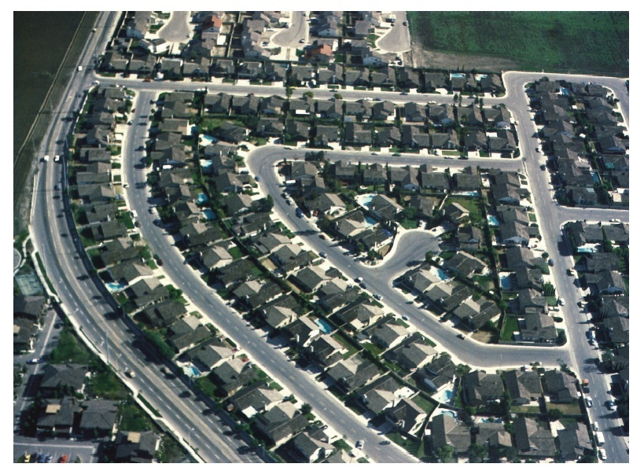
Cluster Sampling
Area Sampling
A form of cluster sampling
The geographic area is divided into clusters.
E.g., city blocks or subdivisions
MKTG 2341 Lec 8
Notes:
Ex: Abbotsford is planning to expands its recreational facilities and wants to research the specific needs among its citizens.

Slide 24
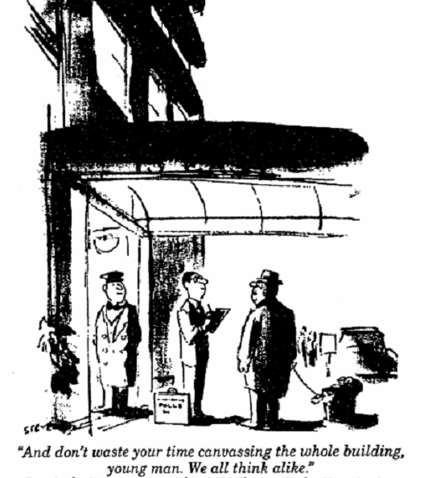
MKTG 2341 Lec 8
Notes:
Drawing by Stevens. Copyright 1980 by the New Yorker Magazine Inc. – not much has changed!!

Slide 25
Probability Sampling Methods
Stratified Sampling:
When the researcher knows the answers to the research question are likely to vary by subgroups.
Population is separated into different strata and a sample is taken from each.
MKTG 2341 Lec 8
Notes:
Ex: if you know that heavy users of a product differ from light users, you can divide the population into these two strata and then randomly draw within each.

Slide 26
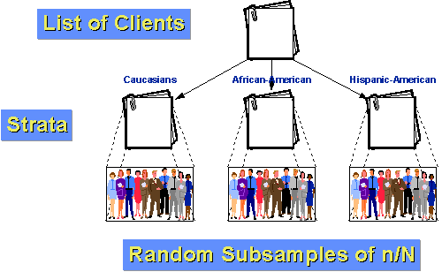
Stratified Sampling
MKTG 2341 Lec 8

Slide 27
Stratified versus Cluster Sampling
Cluster Sampling
Groups are similar (homogeneity between clusters)
High variation within each group (heterogeneity within clusters)
Random selection of groups (clusters)
Stratified Sampling
Groups are different (heterogeneity between strata)
Low variation within each group (homogeneity within strata)
Researching all groups (strata)
MKTG 2341 Lec 8

Slide 28
Example
Cluster Sampling
New subdivisions in Abbotsford are in similar economic brackets.
Divide into similar clusters (blocks).
Randomly select 2-3 clusters and survey every household within the clusters (blocks).
Stratified Sampling
Burnaby has great variety across neighbourhoods.
Households with children differ in their recreational needs from households without children.
Divide the population into two strata: households with or without children.
Randomly select households within these strata.
MKTG 2341 Lec 8
Notes:
Research on citizen’s recreational needs.

Slide 29
Non-Probability Sampling
Non-probability sampling is based on non-random selection of units.
Non-Probability Methods:
  Convenience sampling
  Judgment sampling
  Referral sampling
  Quota sampling
MKTG 2341 Lec 8

Slide 30
Non-Probability Sampling
While non-probability samples are not representative they are still frequently used.
Why?
  Decision makers want fast, relatively inexpensive answers.
  Techniques can vastly improve the quality of some non-probability samples.
MKTG 2341 Lec 8
Notes:
Ways to improve the non-probability samples:
Introduce an element of randomness – ex in mall-intercept surveys ask every 3rd person
Introduce quotas based on variables having an effect on the behaviour – ex age, gender etc.

Slide 31
Non-Probability Sampling
Convenience Samples:
Samples drawn at the convenience of the interviewer
E.g., mall-intercept sample
Errors:
  Different demographic profile of each mall.
  People who are infrequent or non-users of that location will not be sampled.
MKTG 2341 Lec 8

Slide 32
Non-Probability Sampling
Judgment Samples:
Samples that require a judgment or an “educated guess” as to who should represent the population
Subjective, biased:
  Certain members will have a smaller chance of selection than others.
  Depends on the researcher’s perspective.
MKTG 2341 Lec 8

Slide 33
Non-Probability Sampling
Referral Samples (Snowball Samples):
Samples where respondents provide the names of additional respondents.
Used when reaching small, specialized target populations.
Error:
  Members of the population who are less known have a lower probability of being selected.
MKTG 2341 Lec 8

Slide 34
Non-Probability Sampling
Quota Samples:
Specific quotas of certain types of individuals.
Ensuring desired proportion of various respondent classes.
E.g., Stats Canada demographic profile.
Often used to improve mall-intercept samples.
Error:
  Much better than basic mall-intercept but still bound to certain locations.
MKTG 2341 Lec 8

Slide 35
Online Sampling Techniques
Three main types of online sampling:
Random Online Intercept Sampling
Invitation Online Sampling
Online Panel Sampling
MKTG 2341 Lec 8

Slide 36
Online Sampling Techniques
Random Online Intercept Sampling:
Relies on a random selection of website visitors.
Target Population:
  If target population is the website visitors, this is like a simple random sample.
  If the target population is more than the website visitors, it will be a non-probability sample like a mall-intercept method.
MKTG 2341 Lec 8

Slide 37
Online Sampling Techniques
Invitation Online Sampling:
When potential respondents are invited to fill out a questionnaire at a specific website.
Sample frame example:
  E-mails of customers
  Website printed on back of receipts
To avoid spam, the researcher must have prior relationship with e-mail owner.
MKTG 2341 Lec 8
Notes:
Example Old Navy

Slide 38
Online Sampling Techniques
Online Panel Sampling:
Developed by research companies to conduct surveys with representative samples.
Not a probability sample but reasonably high representativeness.
Growing trend
  High quality – close to probability.
  High response rate.
MKTG 2341 Lec 8
Notes:
NOTE: Online panels can provide probability samples if Random Digit Dialing is used to recruit panel members.

Slide 39
City of Burnaby
Questions:
What sampling method would you use for the parks, recreation and culture survey?
Why choose that method?
MKTG 2341 Lec 8
Notes:
Christine:
If we define the target audience as users of the website Overdrive, a Random Online Intercept Sampling would be an appropriate probability sample.
However, If we define the target audience to also include potential users of the website Overdrive, an online panel would be more cost effective.

Slide 40
Developing a Sample Plan
Step 8: Develop & Execute Operational Plan
Step 2: Analyze
Research Method
Step 7: Validate the Sample
Step 1: Define the Population
Step 6: Draw the Sample
Step 3: Choose Sampling Frame
Step 5: Determine Sample Size
Step 4: Select a Sampling Method
MKTG 2341 Lec 8
Notes:
We covered steps 1-4. Chapter 10 will cover Step 5 Sample Size.

Slide 41
Step 5: Determine Sample Size
Second half of lecture outlines how to calculate sample sizes for probability samples.
MKTG 2341 Lec 8

Slide 42
Step 6: Draw the Sample
Substitution Methods:
Drop-down substitution used:
  Systematic (using skip patterns on a list)
  Intercept (asking every 3rd person)
Over-sampling
  Knowledge of response and refusal rates
Re-sampling
  If high refusal rates an additional sample must be drawn
  Must control for overlapping samples.
MKTG 2341 Lec 8

Slide 43
Step 7: Validate the Sample
Sample Validation
A process in which the researcher inspects specific characteristics of the sample (e.g., age and gender) to judge how well it represents the population.
Re-sample, if necessary.
MKTG 2341 Lec 8

Slide 44
Step 8: Develop & Execute The Plan
Operational Plan:
Careful instructions for the sample selection must be drawn up.
The more detailed the instructions, the less selection bias.
During the execution, quality controls must be in place.
MKTG 2341 Lec 8

Slide 45
Determining Sample Size
MKTG 2341 Lec 8

Slide 46
Sample Concepts
Sample Accuracy: refers to how close a random sample’s statistic is to the true population’s value it represents
We express sample accuracy in terms of Sampling Error.
MKTG 2341 Lec 8

Slide 47
Sample Concepts
Two types of error:
  Sampling Error: involves sample selection and sample size.
  Non-Sampling Error: all sources of error other than sample selection size.
MKTG 2341 Lec 8

Slide 48
How to Interpret Sample Accuracy
From a report or news article…
  “Results are accurate ± 5%, 19 times out of 20.”
  Finding: 60% are aware of our brand.
Interpretation:
  If we repeated the same survey 20 times, in 19 out of those 20 times we know that we would get a brand awareness measure between 55% (60%-5%) and 65% (60%+5%).
MKTG 2341 Lec 8
Notes:
19 out of 20 times refers to the 95% level of confidence.

Slide 49

Sample Size Axioms
To properly understand how to determine sample size, it helps to understand the following 8 axioms.
CAUTION:
Only relevant for
Probability Samples!
MKTG 2341 Lec 8

Slide 50
Sample Size Axioms
The only perfectly accurate sample is a census.
A probability sample will always have some inaccuracy (sample error).
The larger a probability sample is, the more accurate it is (less sample error).
MKTG 2341 Lec 8

Slide 51
Sample Size Axioms
Probability sample accuracy (error) can be calculated with a simple formula, and expressed as a ±% number.
You can take any finding in the survey, replicate the survey with the same probability sample size, and you will be “very likely” to find the same finding within the ±% range of the original finding.
MKTG 2341 Lec 8

Slide 52
Sample Size Axioms
In almost all cases, the accuracy (sample error) of a probability sample is independent of the size of the population.
A probability sample can be a very tiny percentage of the population size and still be very accurate (have little sample error).
MKTG 2341 Lec 8

Slide 53
Sample Size Axiom
The size of the probability sample depends on the client’s desired accuracy (acceptable sample error) balanced against the cost of data collection for that sample size.
MKTG 2341 Lec 8

Slide 54
Putting it All Together
MR – What level of accuracy do you want?
MM – I don’t have a clue.
MR – National opinion polls use 3.5%.
MM – Sounds good to me.
MR – Okay, that means we need a sample of 1,200.
MM – Gee Whiz. That small?
MR – Yup, and at a cost of $20 per completion, it will be $24,000.
MM – Holy Cow! That much?
MR – I could do 500 for $10,000, and that would be 4.4% accurate, or 300 for $6,000 at 5.7%.
MM – 500 sounds good to me.
The size of a probability sample depends on the client’s desired accuracy (acceptable sample error) balanced against the cost of data collection for that sample size.
MKTG 2341 Lec 8

Slide 55
There is only one method of determining sample size that allows the researcher to pre-determine the accuracy of sample results…
The Confidence Interval Method of
Determining Sample Size
MKTG 2341 Lec 8

Slide 56
The Confidence Interval Method
Confidence Interval Approach applies the concepts of:
  Accuracy
  Variability (how similar/dissimilar the responses are
  Confidence Interval
- to create a “correct” sample size.
MKTG 2341 Lec 8
Notes:
Variability: how similar/dissimilar the responses are in the data.

Slide 57

The Confidence Interval Method
Accuracy: expressed as sample error.
p: percent (saying Yes) q: 100%-p (saying No)
Variability:
(p*q)
MKTG 2341 Lec 8
Notes:
Accuracy:
Sample error formula is for categorical data.
Same principle applies to metric data (such as a rating scale), but the formula is slightly different.
Variability:
Measured by (p*q)
How similar/dissimilar responses are to a given question
Important point:
the more variability in the population, the higher the sample size needed to achieve a stated level of accuracy.

Slide 58
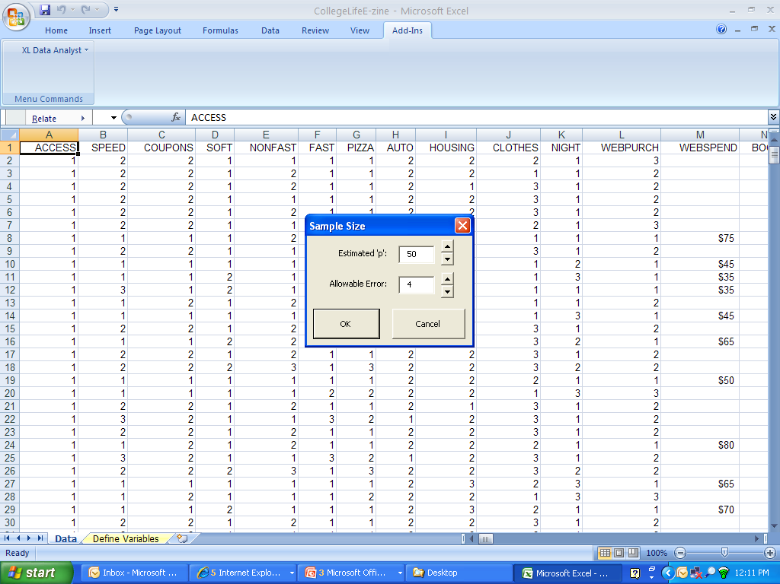
The XLDA Sample Size Calculator
NOTE: XLDA refers to ‘sample error’ as ‘allowable error’
MKTG 2341 Lec 8

Slide 59
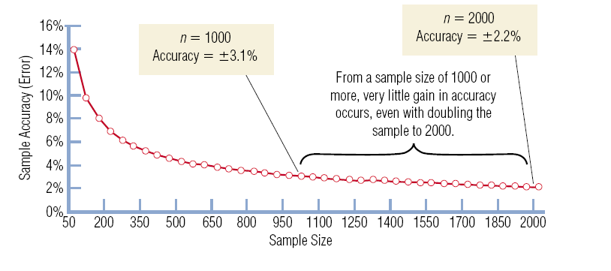
The Confidence Interval Method
The relationship between sample size and sample error:
MKTG 2341 Lec 8

Slide 60
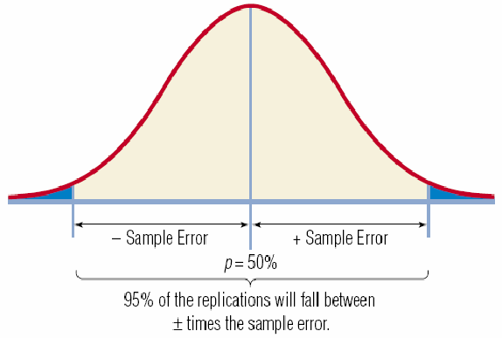
The Confidence Interval Method
Confidence Interval
Range whose endpoints define a certain percentage of the response to a question.
MKTG 2341 Lec 8
Notes:
For 95%:
1.96 x standard deviation (s.d.) defines the endpoints of the distribution.

Slide 61
Confidence Intervals
Confidence Interval:
If we repeated our study 20 times, we would expect the results to fall within a known range in 19 of those times.
Based upon this, we say that we are 95% confident that the true population value falls within this range.
MKTG 2341 Lec 8
Notes:
This is based on the CENTRAL LIMITS THEOREM

Slide 62
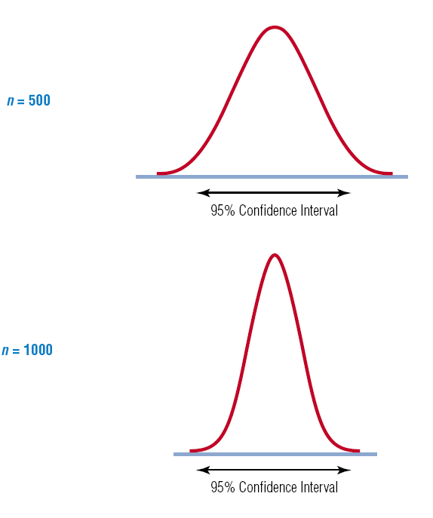
Confidence Intervals
We also know that, given the amount of variability in the population, the sample size will affect the size of the confidence interval.
MKTG 2341 Lec 8

Slide 63
What have we learned so far?
There is a relationship between:
  the amount of Acceptable Sample Error (Desired Accuracy) we wish to have,
  Variability in the population,
  the Level of Confidence we wish to have,
  … and the Sample Size!
MKTG 2341 Lec 8

Slide 64

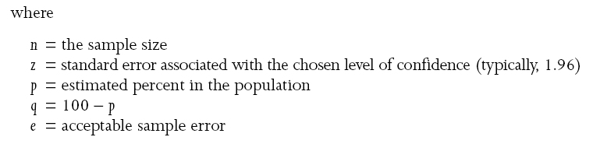
Sample Size Formula
Standard sample size formula for estimating a percentage (p.296):
MKTG 2341 Lec 8
Notes:
Fortunately, statisticians have given us a formula which is based upon these relationships.
The formula requires that we
Specify the amount of confidence we wish
Estimate the variance in the population
Specify the amount of desired accuracy
When we specify the above, the formula tells us what sample size (n) we need to use.

Slide 65
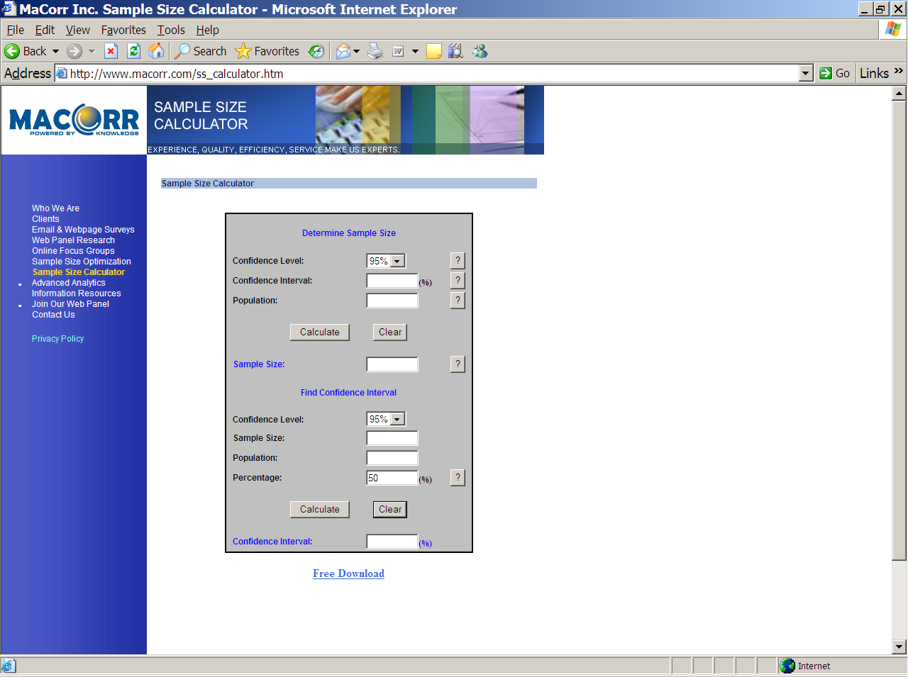
MKTG 2341 Lec 8
Notes:
Alternatively you can use one of the many online Sample Size calculators such as:
http://www.macorr.com/ss_calculator.htm

Slide 66
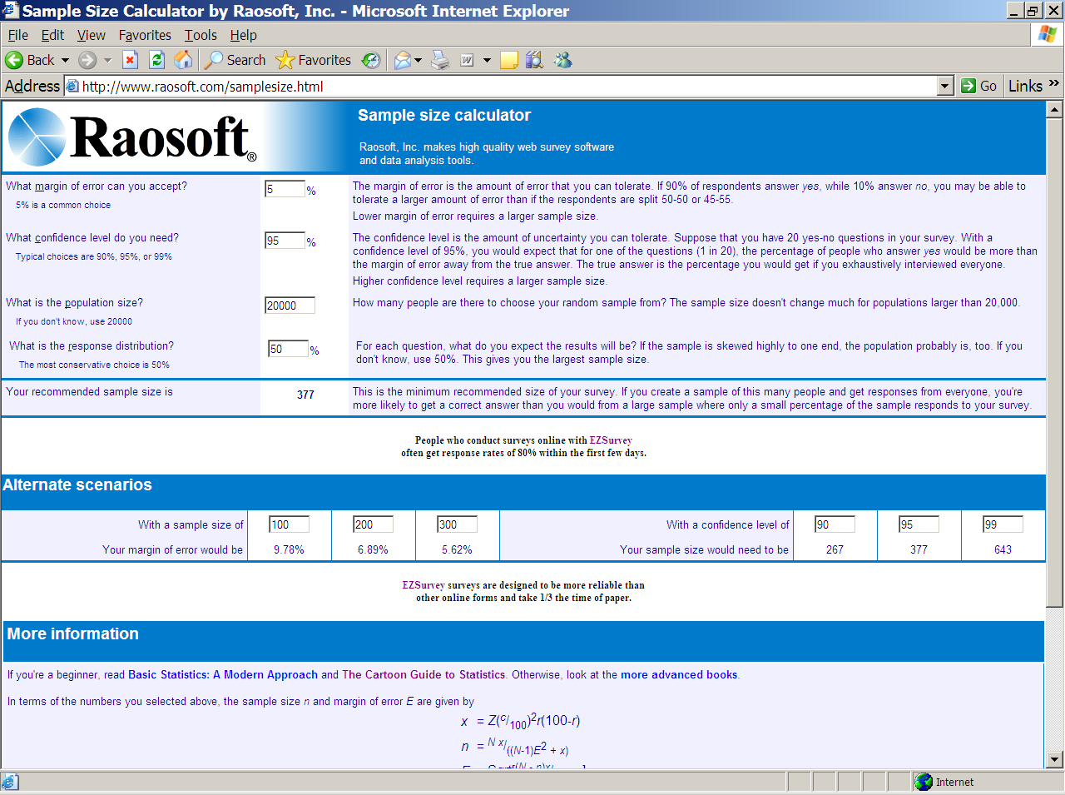
MKTG 2341 Lec 8
Notes:
Alternatively you can use one of the many online Sample Size calculators such as:
http://www.raosoft.com/samplesize.html

Slide 67
Practical Considerations in Sample Size Determination
How to estimate variability (p times q) in the population
  Base your estimate on maximum variability in responses (p=50; q=50)
  Estimate variability: based on previous studies? Conduct a pilot study?
MKTG 2341 Lec 8

Slide 68
Practical Considerations in Sample Size Determination
How to determine the amount of acceptable sample error:
  How much error is the manager willing to tolerate?
  Convention is + or – 5%
  The more important the decision, the lower the acceptable the sample error.
MKTG 2341 Lec 8

Slide 69
Practical Considerations in Sample Size Determination
How to decide on the level of confidence:
  Convention is 95% (z=1.96)
  The more confidence desired, the larger the sample size.
  The more important the decision, the desired confidence may increase to e.g. 99% confidence, z=2.58.
MKTG 2341 Lec 8

Slide 70
Sample Size & Population Size
How does size of the population, N affect the sample size calculation?
Population Size | e=±3% Sample Size | e=±4% Sample Size
10,000 | ____ | ____
100,000 | ____ | ____
1,000,000 | ____ | ____
100,000,000 | ____ | ____
1,067 | 600
1,067 | 600
1,067 | 600
1,067 | 600
In almost all cases, the accuracy (sample error) of a probability sample is independent of the size of the population.
MKTG 2341 Lec 8

Slide 71
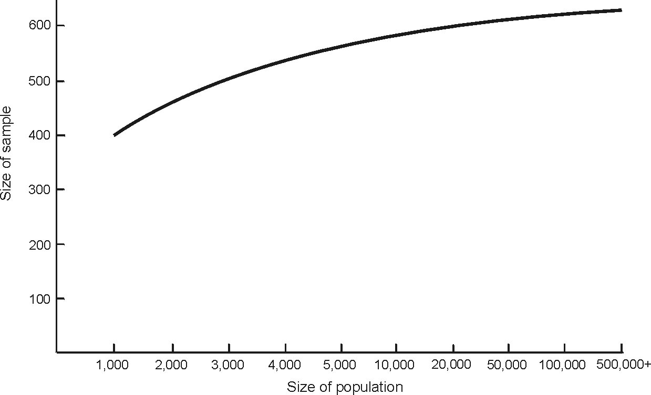
Required Sample Size to Maintain Constant Margin of Error
MKTG 2341 Lec 8

Slide 72
Sample Size & Population Size
How does the size of the population, N, affect sample size or sample error?
Population Size | e=±3% Sample Size | Sample as % of the Population
10,000 | ____ | ___%
100,000 | ____ | ___%
1,000,000 | ____ | ___%
100,000,000 | ____ | ___%
1,067 | 1%
1,067 | .1%
1,067 | .01%
1,067 | .0001%
A probability sample size can be a very tiny percentage of the population size and still be very accurate (have little sample error).
MKTG 2341 Lec 8

Slide 73
Review: What does sample accuracy mean?
95% Accuracy
  Calculate your sample’s finding, p%
  Calculate your sample’s accuracy, ± e%
  You will be 95% confident that the population percentage (π) lies between p% ± e%
MKTG 2341 Lec 8

Slide 74
Other Methods of Sample Size Determination
Rules of thumb.
Tradition – some number believed be the right sample size.
Statistical analysis requirements may influence min. sample size.
Cost basis (“All you can afford”)
… all of these are flawed methods!
MKTG 2341 Lec 8

Slide 75
Special Sample Size Issue
Sampling from small populations:
  Small population: sample exceeds 5% of total population size
  Finite multiplier: adjustment factor for sample size formula
MKTG 2341 Lec 8
Notes:
Appropriate use of the finite multiplier formula will reduce a calculated sample size and save money when performing research on small populations.

Slide 76
Non-Probability Sample Size
Can not use the calculation.
Sample size is unrelated to accuracy, so cost-benefit considerations must be used.
Now let’s bring it all together
… with an example!
MKTG 2341 Lec 8

Slide 77
Reminder!
DATA COLLECTION:
Finish questionnaire development this week.
Start data collection ASAP.
Set up your Excel database
MKTG 2341 Lec 8

